Slide 1
SAT AND ACT participation
DSI – 11 - SF
EMILY LIN

Slide 2
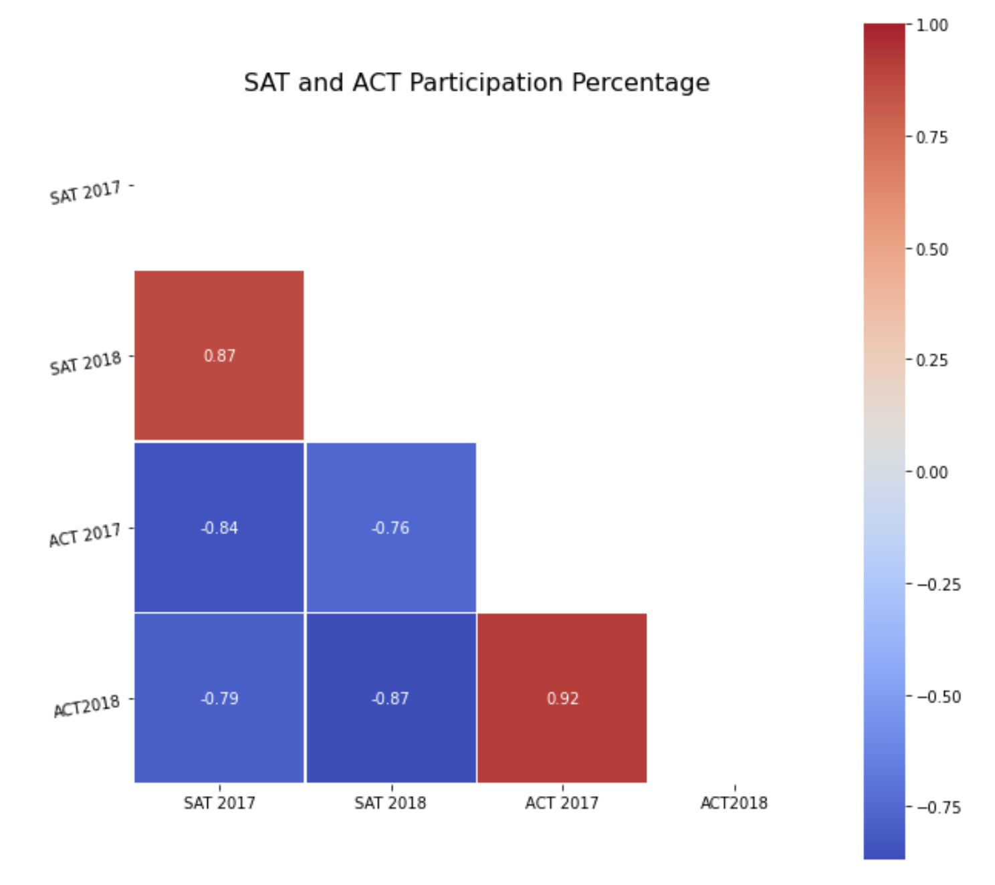
act participation negatively impacts sat participation
Notes:
- students don't like to take tests.
- tests are expensive
- state education policies affect participation rate
- but tests are not mutually exclusive meaning students can take both tests

Slide 3
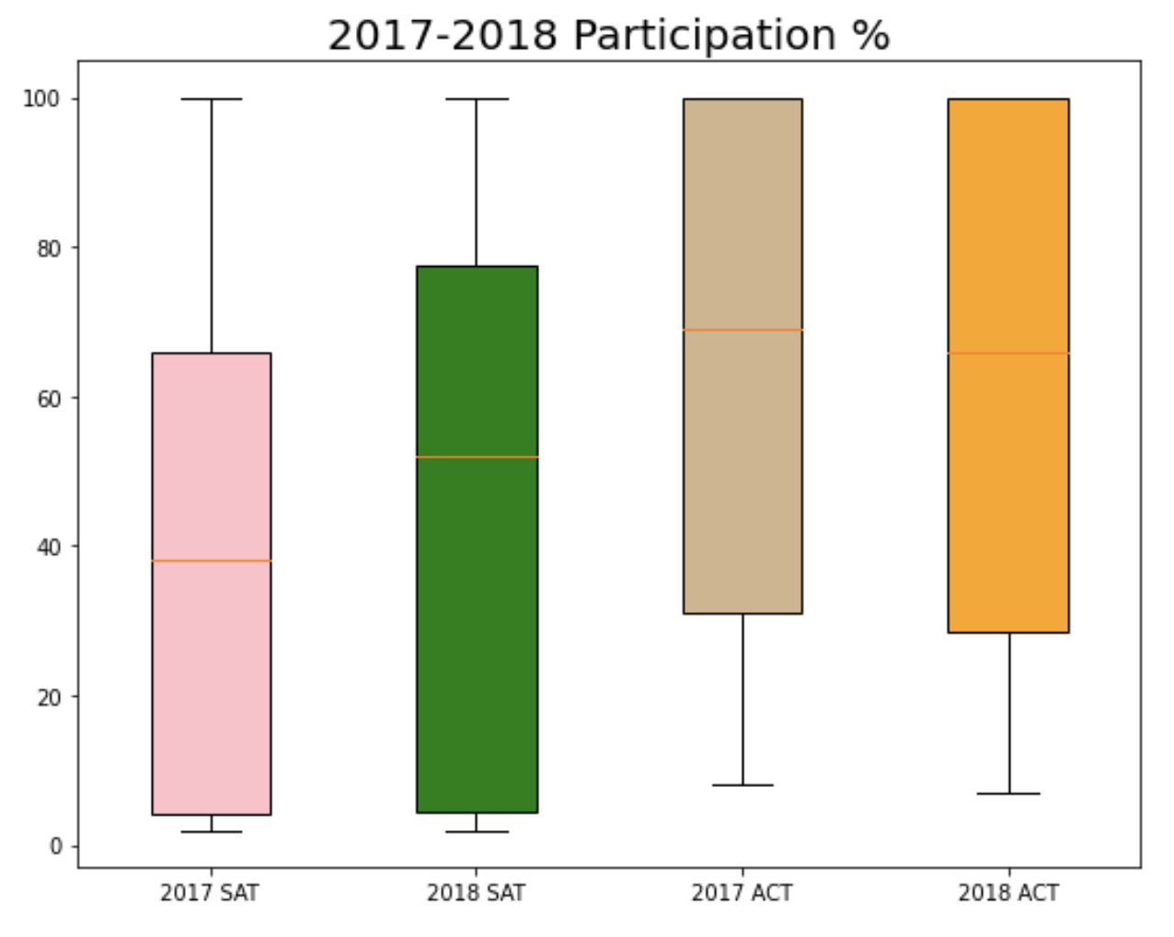
Act participation % is higher than sat participation %
69%
66%
52%
Cost of ACT + writing: $68
Cost of SAT: + essay: $64.50
Federal government requires all the states to administer a summative test in public high schools as a student outcomes measurement.
38%

Slide 4
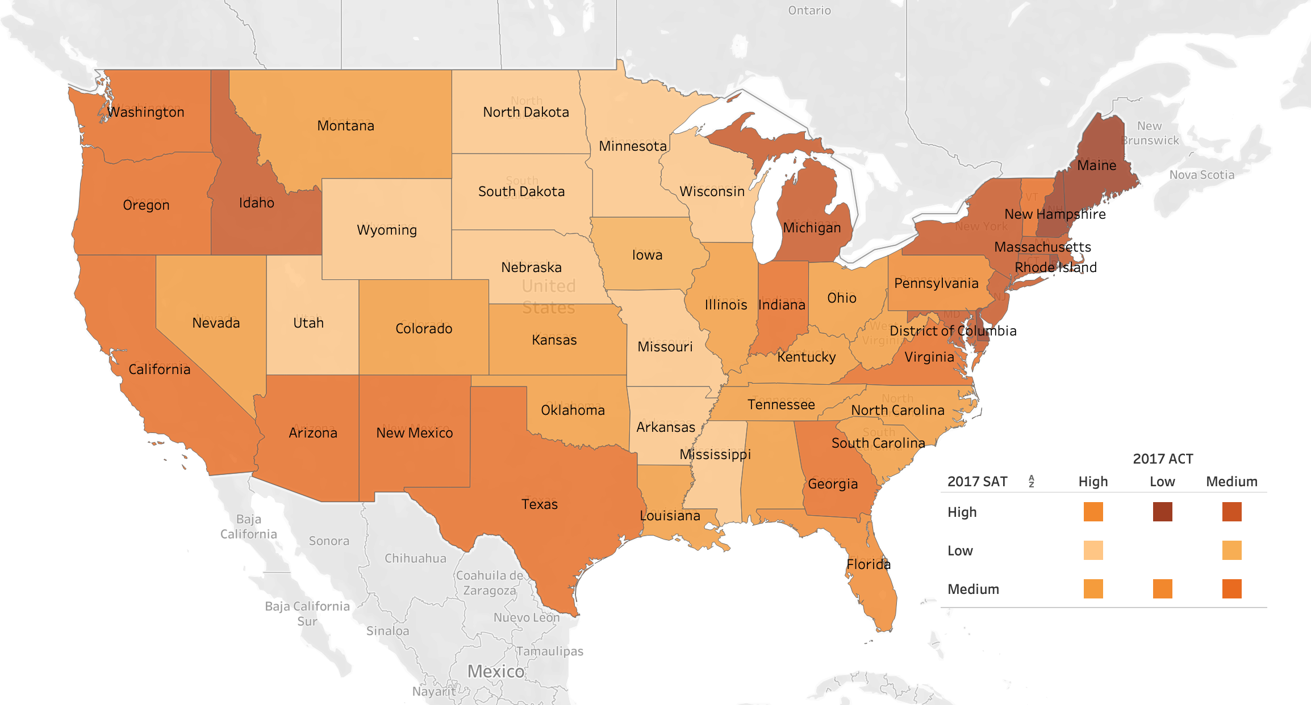
2017 sat vs act participation
States than administer stated-funded ACT¹
Alabama
Hawaii
Idaho
Kentucky
Louisiana
Mississippi
Missouri
Montana
Nebraska
Nevada
North Carolina
North Dakota
Ohio
South Carolina
Tennessee
Utah
Wisconsin
Wyoming
Source: 1. https://www.testive.com/state-sat-act/

Slide 5
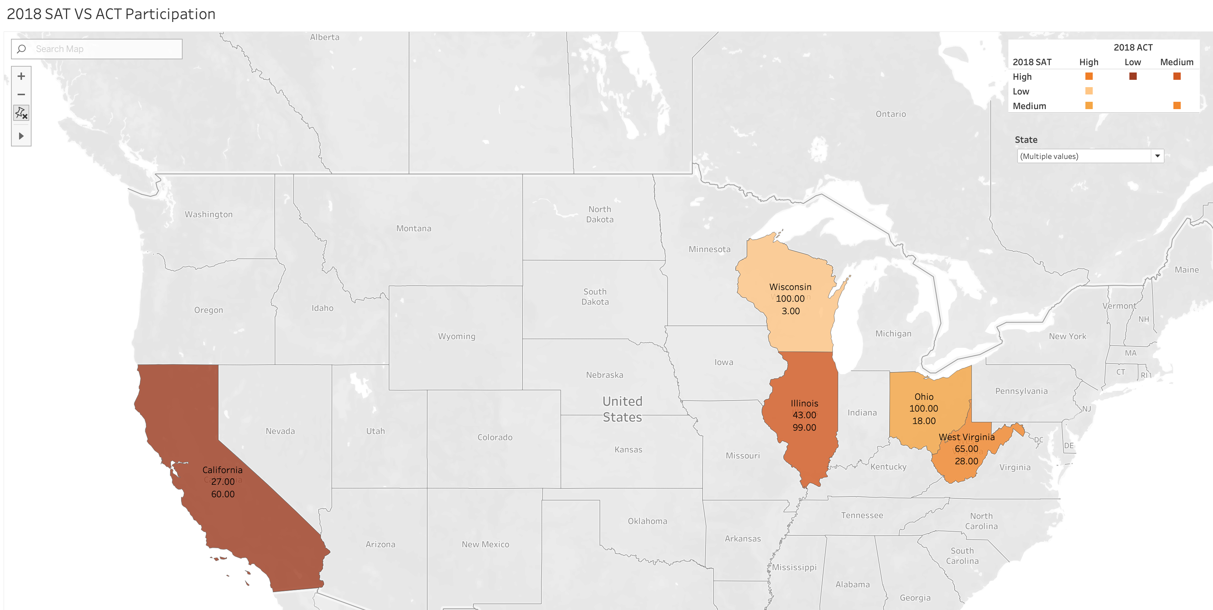
2018 sat vs act participation

Slide 6
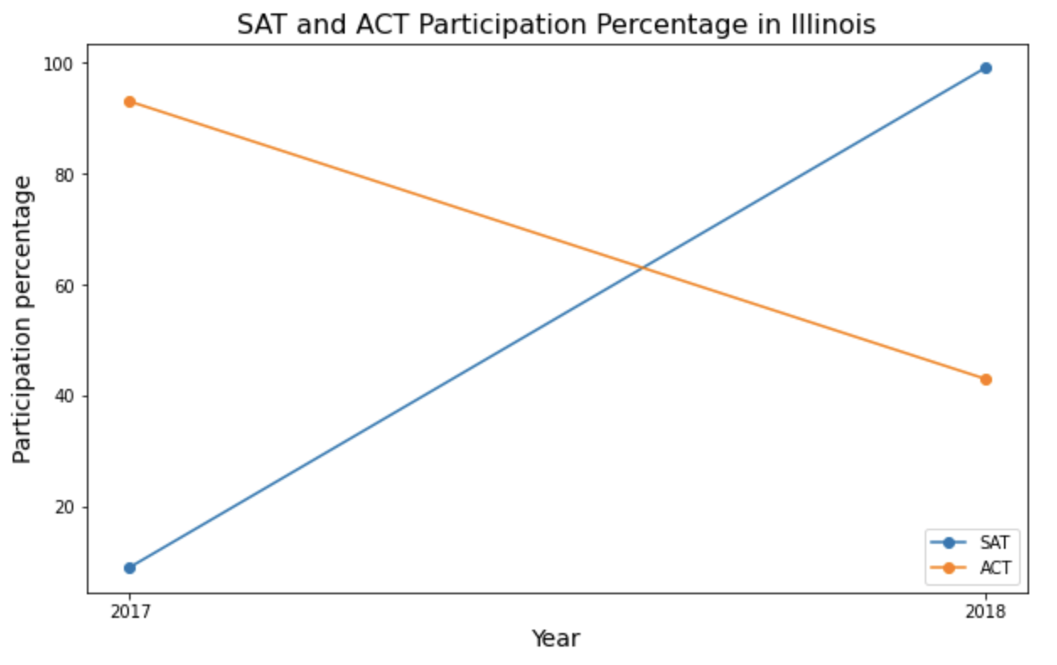
Illinois
99%
93%
Stated funded SAT tests in all public high schools starting in 2016-2017 school year. ¹
Also provides free PSAT TO 9th and 10th graders. ¹
Multi-year contract with the Illinois Department of Education.
43%
9%
Notes:
Illinois is an example of success that highlights how the importance of partnership. The multi-year contract with the Department of Education. The key takeaway is that a multi-year contract. Can we replicate it elsewhere?

Slide 7
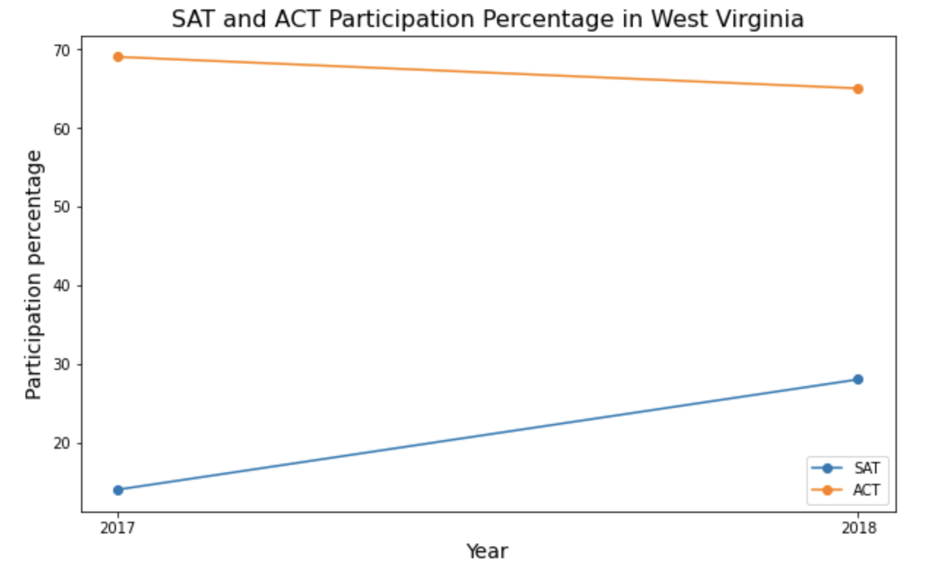
West Virginia
69%
65%
Beginning in spring 2018, the state requires all public schools to administer the SAT as a summative test in 11th grade. ¹
Peer influence
Test Preps
28%
14%
Sources:
1. Quin, Ryan. “WV chooses SAT as new high school standardized test for juniors”. https://www.wvgazettemail.com/news/education/wv-chooses-sat-as-new-high-school-standardized-test-for/article_b60d2618-4943-56f6-b180-4b4442172ef8.html

Slide 8
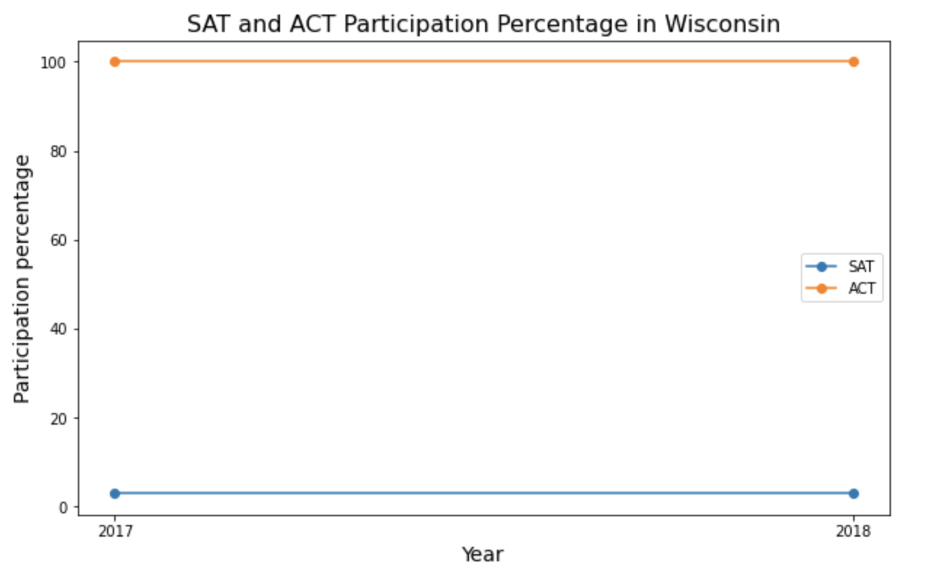
Wisconsin
100%
100%
Required by the state that all students must take the ACT.¹
Ambassadors
Free test preps
Vouchers
3%
3%
1. Heimbach, Alex. “Which State Require the ACT? Full List and Advice”. https://blog.prepscholar.com/which-states-require-the-act-full-list-and-advice

Slide 9
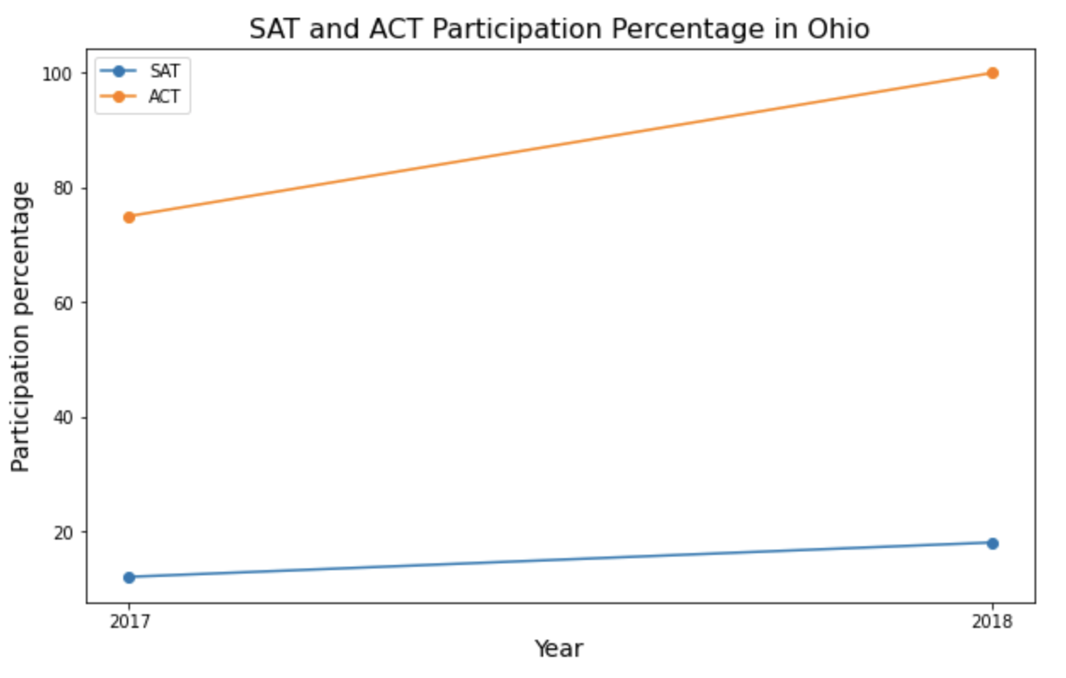
Focus on Ohio
100%
75%
Requires all schools to administer the state funded ACT or SAT. ¹
- Familiarity
- Peer influence
- Expand to administering PSAT to all 9th and 10th graders.
18%
12%
Source:
1. Ohio Department of Education, http://education.ohio.gov/Topics/Testing/State-Funded-SAT-Test
Notes:
Do students take psat have higher sat score? Higher participation rate?

Slide 10
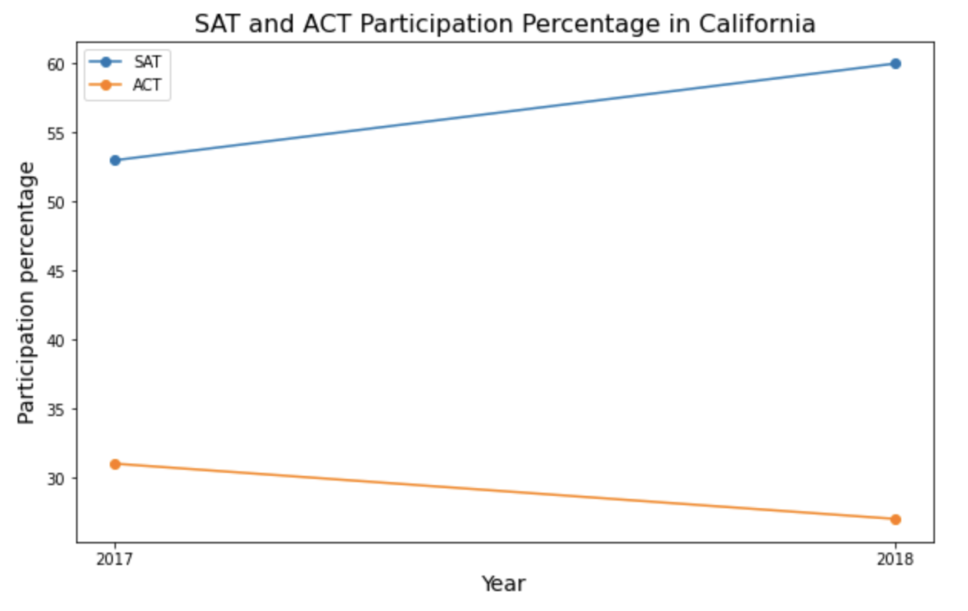
Focus on California
60%
53%
Policies vary by school district. Some school districts offer SAT school day, some do not. ¹
Collaborating with local school superintendents rather than state.
Test preps
31%
27%
Sources:
1. Fensterward, John. “Growing number of California school districts offer students free college entrance exam”. https://edsource.org/2017/more-evidence-supports-school-districts-that-offer-free-satact-to-all-students/585696

Slide 11
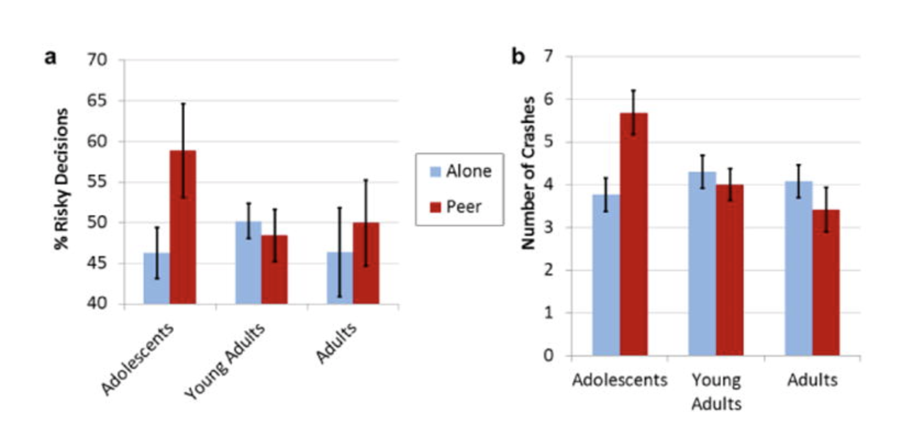
Peer influence and adolescent behavior¹
Not perfect but it is a quite impact factor to consider whether students take the SAT.
1. Albert, Dustin. Chein, Jason. Steinberg, Laurence. Peer Influences on Adolescent Decision Making. https://www.ncbi.nlm.nih.gov/pmc/articles/PMC4276317/

Slide 12
conclusion
Partnership with school districts are the key to expanding SAT participation.
Working with education non-profits to expand the availability of exams to more students.
Students already taking AP classes.
Factors that affect SAT participation but cannot be inferred from the data:
Students are heavily influenced by peers.
Availability of test preps could influence students’ test decision
Exam cost
Availability of exam

